Slide 1
仆人的心志—迦勒(3)
Servant's Heart - Caleb (3)
民13:30-33
Numbers13:30-33
2/23-25/2024 莱城基督教会

Slide 2
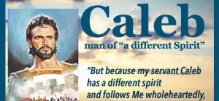
I.前言--
仆人的特质:
❶亲近神的摩西--倚靠，谦和，代求，担罪
❷事奉神的约书亚—忠诚，勇敢，顺从，嫉恶
❸传福音的迦勒—信心，专一，鼓励，老壮
❹求复兴的尼希米—爱心，领导，坚定，牺牲
The qualities of servants:
Moses, who drew near to God - reliance, humility, intercession, bearing burdens.
Joshua, who served God - loyalty, courage, obedience, jealousy for righteousness.
Caleb, who proclaimed the gospel - faithfulness, dedication, encouragement, vigor.
Nehemiah, who sought revival - love, leadership, steadfastness, sacrifice.

Slide 3
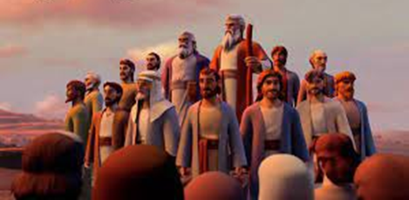
II.满有信心的探子迦勒--
1.杰出的支派领袖:Confident Scout Caleb -Outstanding Tribal Leader:"
「耶和华晓谕摩西说、你打发人去窥探我所赐给以色列人的迦南地、他们每支派中要打发一个人、都要作首领的。摩西就照耶和华的吩咐、从巴兰的旷野打发他们去、他们都是以色列人的族长……属犹大支派的、有耶孚尼的儿子迦勒。」（民13:1-6）
"The Lord said to Moses, 'Send some men to explore the land of Canaan, which I am giving to the Israelites. From each ancestral tribe send one of its leaders.' So at the Lord's command Moses sent them out from the Desert of Paran. All of them were leaders of the Israelites... From the tribe of Judah, Caleb son of Jephunneh was selected.'" (Numbers 13:1-6)
❶窥探为要试验百姓"Exploration to test the people."
❷被选派的都是精英"The selected ones are all elites."

Slide 4
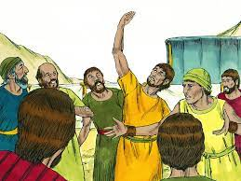
2.力挽狂澜的迦勒: "Caleb, who turned the tide."
「迦勒在摩西面前安抚百姓、说、我们立刻上去得那地吧、我们足能得胜。但那些和他同去的人说、我们不能上去攻击那民、因为他们比我们强壮。探子中有人论到所窥探之地、向以色列人报恶信、说、我们所窥探经过之地、是吞吃居民之地、我们在那里所看见的人民、都身量高大。我们在那里看见亚衲族人、就是伟人、他们是伟人的后裔、据我们看自己就如蚱蜢一样、据他们看我们也是如此。」（民13:30-33）
"Caleb pacified the people before Moses, saying, 'Let us go up at once and take possession, for we are well able to overcome it.' But the men who had gone up with him said, 'We are not able to go up against the people, for they are stronger than we are.' And they gave the children of Israel a bad report of the land which they had spied out, saying, 'The land through which we have gone as spies is a land that devours its inhabitants, and all the people whom we saw in it are men of great stature. There we saw the giants (the descendants of Anak came from the giants); and we were like grasshoppers in our own sight, and so we were in their sight.'" (Numbers 13:30-33)
❶探子们的蚱蜢心态"The scouts' grasshopper mentality."
❷迦勒想要安抚百姓
"Caleb sought to pacify the people."

Slide 5
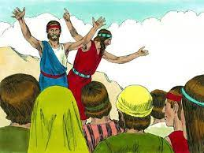
3.信心—堅持不變到底: "Faith - persevering to the end."
「窥探地的人中、嫩的儿子约书亚、和耶孚尼的儿子迦勒、撕裂衣服、对以色列全会众说、我们所窥探经过之地、是极美之地。耶和华若喜悦我们、就必将我们领进那地、把地赐给我们、那地原是流奶与蜜之地。但你们不可背叛耶和华、也不要怕那地的居民、因为他们是我们的食物、并且荫庇他们的已经离开他们、有耶和华与我们同在、不要怕他们。」（民11:27-29）
"Among the men who had gone to explore the land, Joshua son of Nun and Caleb son of Jephunneh tore their clothes and said to the entire Israelite assembly, 'The land we passed through and explored is exceedingly good. If the Lord is pleased with us, he will lead us into that land, a land flowing with milk and honey, and will give it to us. Only do not rebel against the Lord. And do not be afraid of the people of the land, because we will devour them. Their protection is gone, but the Lord is with us. Do not be afraid of them.'" (Numbers 11:27-29)
❶相信神的应许必然成就"The promise of God will surely be fulfilled through faith."
❷有神同在强敌变为食物
"When God is with us, strong enemies become food."

Slide 6

4.成为余种的迦勒: "Becoming the remnant like Caleb."
「们的尸首必倒在这旷野、并且你们中间凡被数点、从二十岁以外向我发怨言的、必不得进我起誓应许叫你们住的那地、惟有耶孚尼的儿子迦勒和嫩的儿子约书亚、才能进去。……你们的儿女必在旷野飘流四十年、担当你们淫行的罪、直到你们的尸首在旷野消灭。按你们窥探那地的四十日、一年顶一日、你们要担当罪孽四十年、就知道我与你们疏远了。」（民14:29-34）
"Your bodies will fall in this wilderness, and every one of you who was counted, twenty years old or more and who has grumbled against me, will not enter the land I swore with uplifted hand to make your home, except Caleb son of Jephunneh and Joshua son of Nun... Your children will be shepherds here for forty years, suffering for your unfaithfulness, until the last of your bodies lies in the wilderness. For forty years—one year for each of the forty days you explored the land—you will suffer for your sins and know what it is like to have me against you." (Numbers 14:29-34)
❶在旷野漂流不得进入"Drifting in the wilderness without entering."
❷唯有信主的可以蒙恩
"Only those who believe in the Lord can receive grace."

Slide 7
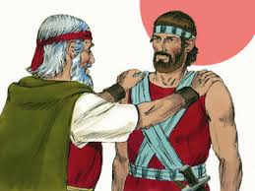
III.老当益壮的长者迦勒-- "The elderly but vigorous elder, Caleb."
1.专心—末後必有賞賜: "Focus - there will be rewards in the end."
「惟独我的仆人迦勒、因他另有一个心志、专一跟从我、我就把他领进他所去过的那地．他的后裔也必得那地为业。」（民14:24）
「惟有耶孚尼的儿子迦勒、必得看见、并且我要将他所踏过的地赐给他、和他的子孙、因为他专心跟从我。」（申1:36）
"Only my servant Caleb, because he has a different spirit and follows me wholeheartedly, I will bring into the land he went to, and his descendants will inherit it." (Numbers 14:24)
"But because my servant Caleb has a different spirit and follows me wholeheartedly, I will bring him into the land he went to, and his descendants will inherit it." (Deuteronomy 1:36)
❶集中注意力在一件事上
"Focus attention on one thing."
❷神赏赐专心跟从祂的人
"God rewards those who follow Him wholeheartedly."

Slide 8
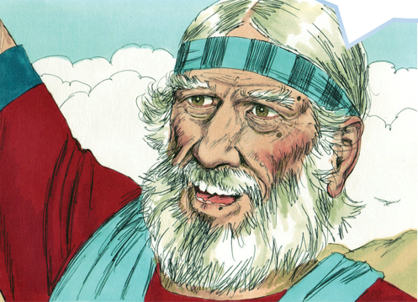
2.老壮—維持身心更新: "Old but vigorous - maintaining physical and mental renewal."
「耶和华的仆人摩西、从加低斯巴尼亚打发我窥探这地、那时我正四十岁．我按着心意回报他……自从耶和华对摩西说这话的时候、耶和华照他所应许的、使我存活这四十五年．其间以色列人在旷野行走．看哪、现今我八十五岁了、我还是强壮、像摩西打发我去的那天一样．无论是争战、是出入、我的力量那时如何、现在还是如何……或者耶和华照他所应许的与我同在、我就把他们赶出去。」（書14:7-11）
"The Lord's servant Moses sent me from Kadesh Barnea to explore the land, and I brought him back a report according to my convictions... Since that time, the Lord has kept me alive for forty-five years as he said, ever since he said this to Moses, while Israel moved about in the wilderness. So here I am today, eighty-five years old! I am still as strong today as the day Moses sent me out; I'm just as vigorous to go out to battle now as I was then... Perhaps the Lord will be with me, and I will drive them out as he said." (Joshua 14:7-11)
❶虽然年老仍然继续征战
"Continuing to battle despite old age."
❷保持身心健康为主所用
"Maintaining physical and mental health for the Lord's use."

Slide 9
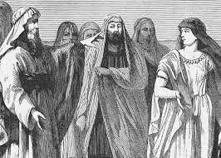
3.鼓励—能作更大的事: "Encouragement - enabling greater achievements."
「迦勒说、谁能攻打基列西弗、将城夺取、我就把我女儿押撒给他为妻。迦勒兄弟基纳斯的儿子俄陀聂、夺取了那城．迦勒就把女儿押撒给他为妻。」（士1:12-13）
「以色列人呼求耶和华的时候、耶和华就为他们兴起一位拯救者救他们、就是迦勒兄弟、基纳斯的儿子俄陀聂。耶和华的灵降在他身上、他就作了以色列的士师、出去争战。」（士3:9-10）
"Then Caleb said, 'Whoever attacks Kiriath Sepher and captures it, I will give my daughter Acsah in marriage.' Othniel son of Kenaz, Caleb’s brother, took it; so Caleb gave his daughter Acsah to him in marriage." (Judges 1:12-13)
"The Israelites cried out to the Lord, and he raised up for them a deliverer, Othniel son of Kenaz, Caleb’s younger brother, who saved them. The Spirit of the Lord came on him, so he became Israel’s judge and went to war." (Judges 3:9-10)
❶用招婿方式招募勇士
"Recruiting warriors through a son-in-law offer."
❷为培养后进不留余力
"Spared no effort in nurturing the successors."

Slide 10
V.主耶稣的榜样-- "The example of the Lord Jesus."
「耶稣就对他们说、我父作事直到如今、我也作事．」（約5:17）
「耶稣知道自己离世归父的时候到了．他既然爱世间属自己的人、就爱他们到底。」（約13:1）
「我实实在在的告诉你们、我所作的事、信我的人也要作．并且要作比这更大的事。」(約14:12）
「所以我们不丧胆．外体虽然毁坏、内心却一天新似一天。」(林後4:16 ）
John 5:17: "Jesus said to them, 'My Father is always at his work to this very day, and I too am working.'"
John 13:1: "It was just before the Passover Festival. Jesus knew that the hour had come for him to leave this world and go to the Father. Having loved his own who were in the world, he loved them to the end."
John 14:12: "Very truly I tell you, whoever believes in me will do the works I have been doing, and they will do even greater things than these, because I am going to the Father."
2 Corinthians 4:16: "Therefore we do not lose heart. Though outwardly we are wasting away, yet inwardly we are being renewed day by day."
❶信心—相信神在动工 "Faith - believing that God is at work."
❷专一—坚持不变到底 "Dedication - staying steadfast until the end."
❸鼓励—能作更大的事 "Encouragement - enabling greater accomplishments."
❹老壮—维持身心健康 "Old but vigorous - maintaining physical and mental health."

Slide 11

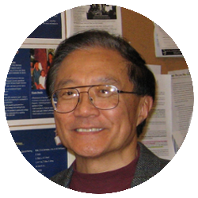

DR. Reggie Tsang
曾振錨 長老
「要相信年轻人爱主的潜力!」
YANF基金
"Believe in the potential of young people to love the Lord."

Slide 12
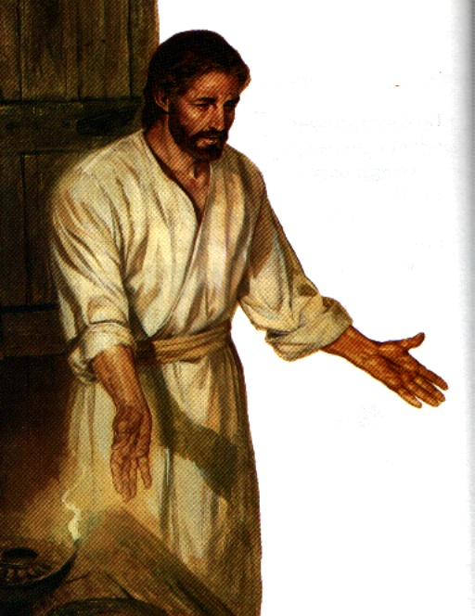
VI.结论﹕conclusion
1.神拣选专一跟从祂的人做领袖。"God chooses those who follow Him wholeheartedly to be leaders."
2.蚱蜢心态是失败最主要原因，受到仇敌表面的威胁。"The grasshopper mentality is the main reason for failure, influenced by the perceived threat of the enemy."
3.有神的同在强敌也变成我们的食物。
"With God's presence, even strong enemies become our food."
4.学习主耶稣的榜样: "Learning from the example of Lord Jesus."
❶信心—相信神在动工 "Faith - believing that God is at work."
❷专心—末后必有赏赐 "Focus - there will be rewards in the end."
❸鼓励—能作更大的事 "Encouragement - enabling greater accomplishments."
❹老壮—维持身心更新 "Old but vigorous - maintaining physical and mental renewal."

Slide 13
终结

